Slide 1
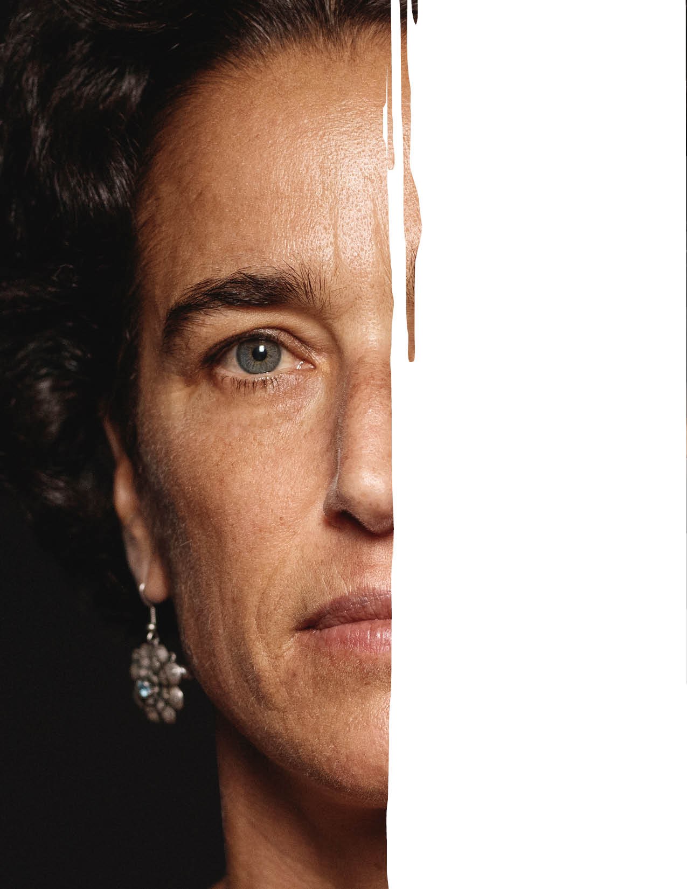

ARE YOU READY TO
BECOME A STROKE SPOTTER?

Slide 2

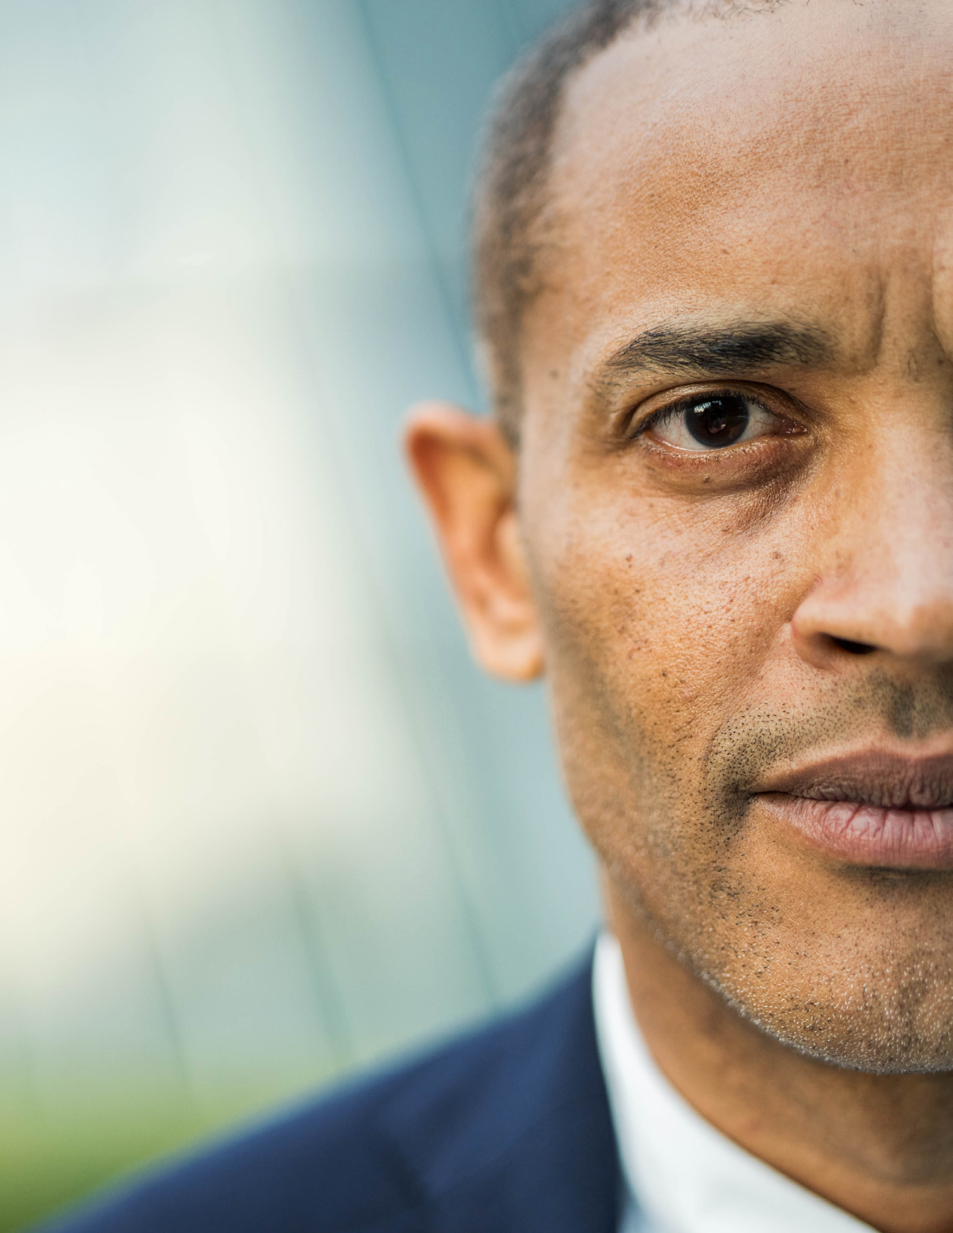
Every 2 seconds, someone has
a stroke.
Stroke can happen
to anyone,
at any moment.

Slide 3
WHEN SOMEONE HAS A STROKE,
Every MINUTE COUNTS.
Fast action
saves lives and improves recovery.

Slide 4


BECOME A STROKE SPOTTER TODAY
1
Watch patients, doctors and experts, explain what to look out for
2
Complete the interactive quiz
3
Test your spotting skills and reaction time
4
Get your “Stroke Spotter” badge
5
Share it with your networks and encourage others to join the challenge

Slide 5

every m1nute counts
Your action today
could change a life tomorrow.
WWW.WORLDSTROKECAMPAIGN.ORG
#WORLDSTROKEDAY
#ACTFAST

