Slide 1
Taking Charge After Stroke
Harry McNaughton
Medical Research Institute of New Zealand
Notes:
Kia ora koutou katoa. Greetings from the indigenous people of Aotearoa New Zealand.

Slide 2
People who achieve amazing things dream of amazing things
Intrinsic motivation is a necessary condition for successful rehabilitation
What the person with stroke can do for themselves, is as much as anything clinicians can do to them
Take Charge puts the person with stroke in the driving seat – where they belong
Take Charge aims for transformation: from a stroke person to a person who happens to have had a stroke

Slide 3
Take Charge is effective
The first time an intervention has been shown to be effective (at the level of participation, independence, quality of life) in the community phase of stroke rehabilitation
Response: How can this be possible?
My job today:
Show how it is possible for Take Charge to be effective
Get you excited about using Take Charge (using it will convince you)
Remind us all to keep the person with stroke at the centre – person-centred care
Some practical issues
Questions
Notes:
So there is level 1a evidence from 2 moderately large randomised controlled trials that Take Charge is effective in the community phase of stroke rehabilitation. The main results of the 2nd trial and the meta-analysis of the 2 trials are available, open access, in this month’s International Journal of Stroke. I am not going to go over those results today in any detail.
A common response to these results has been disbelief. How can an intervention, not started until an average 6 weeks after stroke, that involves one or two sessions of about 60 minutes of talking and no physical therapy, possibly have an impact on important outcomes at 12 months after the stroke?
So I mainly want to address this disbelief, and convince you that interventions like Take Charge can be effective. A good way to convince you is to start using the intervention yourself and see what happens.
I will cover a few practical issues with using the intervention. Feel free to jot down questions as we go and I will try and answer as many of them as I can at the end. My contact details are on the last slide so even if we run out of time contact me on email or twitter and I will get back to you.

Slide 4
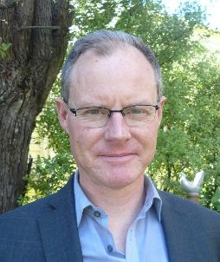
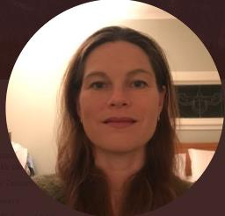
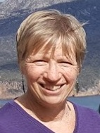
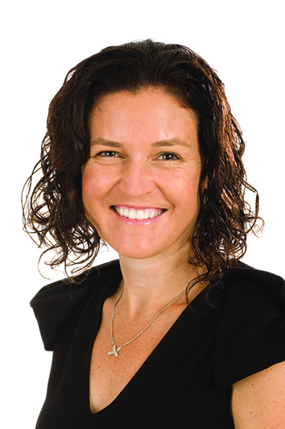
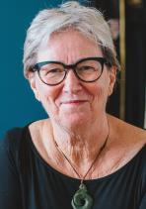
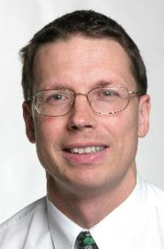
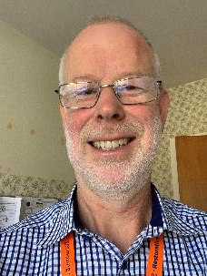
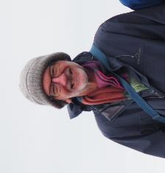
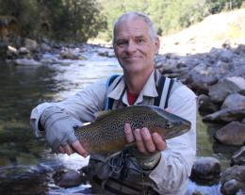
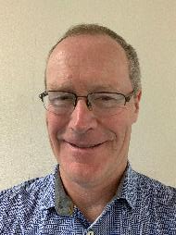
The Take Charge team: 2005-2020
Viv
Will
Matire
Anna R
Judith
Anna M
Kath
Geoff
Api
Harry
Mark
Alan
John
Carl
Tom
Notes:
This was a team effort over many years. Thanks to all the investigators, researchers and back room team at MRINZ.

Slide 5
The ICF
STROKE or other health condition
People in the community value
Hyperacute treatment focus
Body structure & function
Quality of life and independence
Activity limitation
Participation restriction
Personal factors
Personal factors
Personal factors
Orthodox therapy-led rehabilitation focus
Environment
Take Charge focus
Notes:
The WHO’s International Classification of Functioning, usually abbreviated to ICF, is a cornerstone of modern rehabilitation theory and practice. I won’t explain it in too much detail. It is our impression that stroke rehab clinicians tend to see this as a linear process, hence my large blue arrows: the stroke affects body structure and function such as arm weakness, which leads to activity limitation, such as difficulty washing and dressing or walking, which in turn restricts participation in life interactions, like work and voluntary activities and study and reduces quality of life. These are modified by environmental and personal factors.
Surveys of community living adults say consistently that it is outcomes at the level of participation, independence and QoL that are valued the most.The focus of hyperacute treatment is to limit the initial damage.
Rehabilitation orthodoxy promotes a concentration on improving basic and advanced activities of daily living, working on the environment to minimise barriers. We know this improves activities of daily living. Unfortunately several large trials aimed at optimising a therapy-led approach on its own, with more therapy, earlier therapy, different types of therapy, robot-assisted therapy, have failed to show significant benefits for people with stroke at the level of independence and quality of life.
The focus of the Take Charge intervention, is on personal factors, which we think deserves a bigger box. In 2 moderately large randomised trials we have shown that people receiving Take Charge , in addition to best hyperacute treatment combined with guideline-recommended best therapy-led rehabilitation, had significantly better levels of independence and quality of life.

Slide 6
Personal factors
gender, age
social background, education, profession
past and current experience
coping styles
overall behaviour pattern
character
‘and other factors that influence how disability is experienced by the individual’
Intrinsic motivation is a necessary condition for successful rehabilitation
Notes:
Let’s unpack the personal factors box for a minute.
This is how the WHO describes personal factors. The factors in bold strongly influence motivation. Motivation is a difficult concept: hard to measure, no evidence that these personal factors can be manipulated to improve outcomes. So why worry?
So let me make my view clear: Without a motivated person, successful rehabilitation is very difficult. With the Take Charge intervention we have shown that it is possible to manipulate these personal factors to improve outcomes. If we are right, this changes everything.

Slide 7
The Other bits
The Engine
= My Sense of self
‘Who I really am as a person’
The Fuel
= My Intrinsic motivation
Fuel ingredients:
AMP-C
Autonomy – I have choices
Mastery – I can do this
Purpose – Where I want to go
Connectedness – My support crew
Notes:
I want to suggest 3 different ways of looking at Take Charge that may help explain why it works.
The first way asks you to imagine the person with stroke as a car.
The Engine is what defines the car: for the person this is what psychologists call the ‘sense of self’ – who I really am.
The Fuel is what keeps the engine running: for the person this is intrinsic motivation.
The ingredients of the fuel are critical: most important is purpose, then autonomy, mastery and connectedness
All the rest are simply ‘the other bits’, useful but not essential.

Slide 8
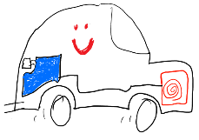
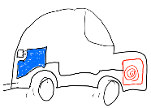
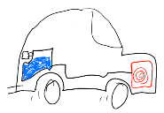
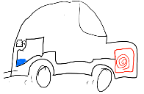
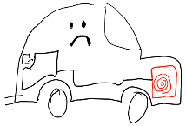
Stroke!
Stroke!
Take Charge
Notes:
Let’s imagine the journey through life of 2 people, both on their way to having a stroke. They both start the journey with a similar amount of fuel.
The upper person has a rich life experience, overcoming adversity and developing resilience, and arrives at the time of stroke with a full tank of fuel, rich with purpose, autonomy and mastery.
The lower person on the other hand goes smoothly through life never really being tested, not quite sure where she or he is headed and arrives at the time of stroke low on fuel, lacking purpose, autonomy and any feeling of mastery.
Although the stroke is likely to temporarily slow down most people, the outcome for the upper person, with a tank full of motivation is likely to be much better than that of the lower one, now completely out of fuel, going nowhere.
Take Charge is an intervention that aims to help the person with stroke top up their fuel: their intrinsic motivation, and improve the trajectory of their recovery.

Slide 9
Intrinsic vs extrinsic motivation
For full story: self-determination theory, Deci & Ryan (full references are in the IJS paper)
Simple version
Intrinsic motivation – internal, personal, your fuel
Extrinsic motivation – external incentive (cash, praise, award)
someone else pushing your car
Notes:
Intrinsic motivation is from within. You are doing this for yourself. External motivators are bribes of some sort. You are doing it to please other people in some way.
Plenty of empirical evidence from the education and psychology literature tells us that students who are extrinsically motivated do worse than those intrinsically motivated. Of course those of you who have, or have had, teenagers know this already. Any gains from external motivators – financial or otherwise – are usually short term. We need to help the person fill up their own fuel tank, not push their car.

Slide 10
Julia
54 years old
Successful businesswoman
Husband and 2 teenage children
Significant stroke with R hemiparesis and aphasia
Thrombolysed @ 2.5 hours without significant change
Transferred to rehab ward Day 7, needing 2 assistants to transfer safely
Notes:
Enough theory. Here is my second illustration of Take Charge. Lets talk about a real person.
Julia had a big stroke with significant motor and language deficits.

Slide 11
‘Rude’
‘Aggressive to staff’
‘Attempts unsafe mobilisation’
‘Husband gets in the way’
‘Dangerous’
‘Doesn’t listen to staff’
‘Demanding’
Notes:
This is what the rehab team said about her in the clinical notes and during multidisciplinary team meetings.
Julia was adamant that she was going to get better and wanted to mobilise as much as possible. She was told she could only mobilise with trained staff . When the physios went home and the nurses retired to their work station after 5 o’clock, Julia would get up by herself and try to walk either on her own or with her husband. She had many falls including one in the toilet where she bruised her whole side against the toilet seat.
She and her husband were in a constant battle with staff to get more therapy, spend more time at home, practice car transfers. Her main priorities were spending time with her family and getting back to work. She was told countless times ‘you can’t run until you have learned to walk again’
We have all seen patients like Julia. I want you to consider whether Julia, and patients like her, in your opinion, is likely to make a better than average outcome, an average outcome or a worse than average outcome?

Slide 12
Julia was intrinsically motivated. She had:
1. A sense of Purpose focussed beyond the stroke itself
2. A very strong sense of Autonomy
3. A strong sense of competence/Mastery
4. Connectedness
The Take Charge intervention
tries to spark, or support, intrinsic motivation for all people with stroke
Notes:
Most people agree that she will make a better than average outcome, which she did.
Julia is Taking Charge. She has plenty of fuel in her tank and will make the very most of her rehabilitation
The Take Charge intervention, encourages a person’s own intrinsic motivation – a combination of Purpose, Autonomy, Mastery and Connectedness. 10.30

Slide 13
Better ability to Take Charge = better outcomes?
With the
Take Charge intervention
Number of people
JULIA
Ability to Take Charge
Better outcomes
Notes:
Our previous qualitative work suggested that there is a Take Charge continuum, not just in stroke but also people with chronic pain and cancer. That work suggested that people more able to take Charge experienced better outcomes.
Julia is already at the extreme end of the Take Charge continuum and could be expected to do better than someone further down this curve.
With the Take Charge intervention we hoped to shift the whole distribution to the right, and by doing so improve average outcomes.

Slide 14
How Take Charge was delivered in the Taking Charge after Stroke (TaCAS) trial
Looking beyond the stroke
Intervention at around 3-16 weeks following stroke, community-living people (not institutional care)
Either one or two sessions, 6 weeks apart, session ~ 60 mins
Trained facilitator
Baseline assessment (ADL, IADL, QoL, independence, risk factors)
Make a Connection
Listen, don’t speak
Reflect: All the ideas from person with stroke and family
Unlimited time – generally about 60 minutes
Independent from usual rehabilitation team
Notes:
So how did we help people top up their fuel tank? In a sentence we aimed to help them Look beyond their stroke. What we actually did was very simple. There is a lot more detail in the training manual
The training only took half a day. The main message for the facilitators was to listen and shut up. The facilitators were not there to coach, simply to listen and reflect. All ideas were from the person with stroke and their family.
I want to emphasise that this intervention was in addition to evidence-based best practice stroke rehabilitation in the hospital and community.

Slide 15
Delivering Take Charge: Up to 60% eligible
Notes:
The Take Charge studies have focussed on people with stroke discharged to community living and who say they are not fully recovered from their stroke.

Slide 16
What Taking Charge is all about
Who I really am
My stroke
My stroke
Me
A person who happens to have had a stroke
A stroke person
Notes:
Here is the third way of looking at Take Charge. This single graphic sums up what we are trying to do. We are aiming for a transformation: from a stroke person on the left, overwhelmed by the effects and baggage of the stroke episode, back into the person they want to be – a person who happens to have a stroke.

Slide 17
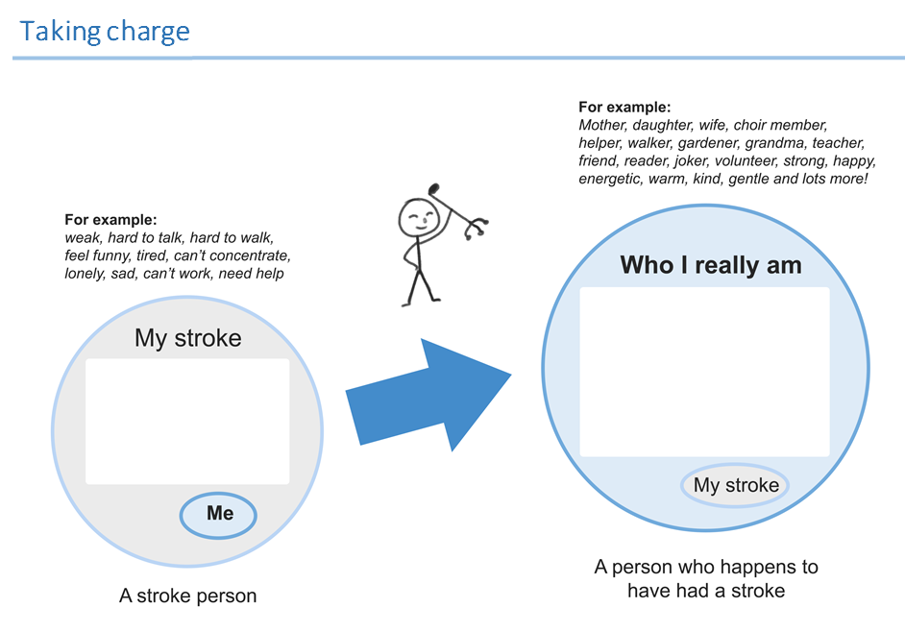
Download from www.mrinz.ac.nz/programmes/stroke
Notes:
The next 3 slides show the first 3 pages of the Take Charge booklet. The whole booklet is available for free download from the mrinz website and I will give you the address at the end. This page tries to work on the 2 circles idea from the previous slide – from a ‘stroke person’ to ‘a person who happens to have had a stroke’. The person with stroke or their family fills in the spaces.

Slide 18
Notes:
This page continues the idea of thinking beyond the stroke. Dreams, hopes, big picture. Sometimes expressing fears is easier than expressing hopes: ‘I’m afraid I won’t be able to read stories to my grandchildren’ is another way of saying ‘Reading stories to my grandchildren is really important to me’

Slide 19
Notes:
Sometimes visualising and drawing is easier and more powerful than writing ideas down. The idea of a ‘Best Day’ is borrowed from palliative care and amazing stuff can come out. The person is asked to visualise a place, people and action. The family often gets involved. There are spare sheets in the booklet for more ideas over time.

Slide 20
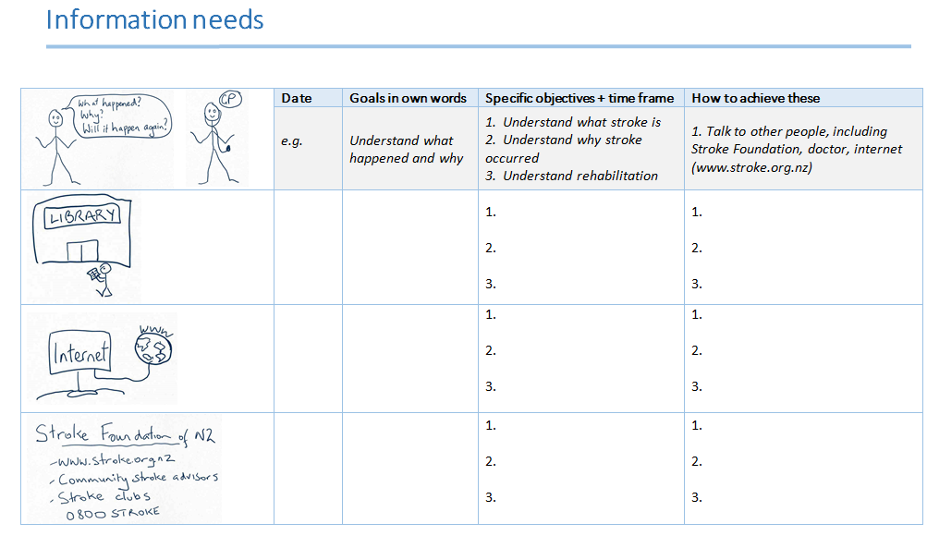
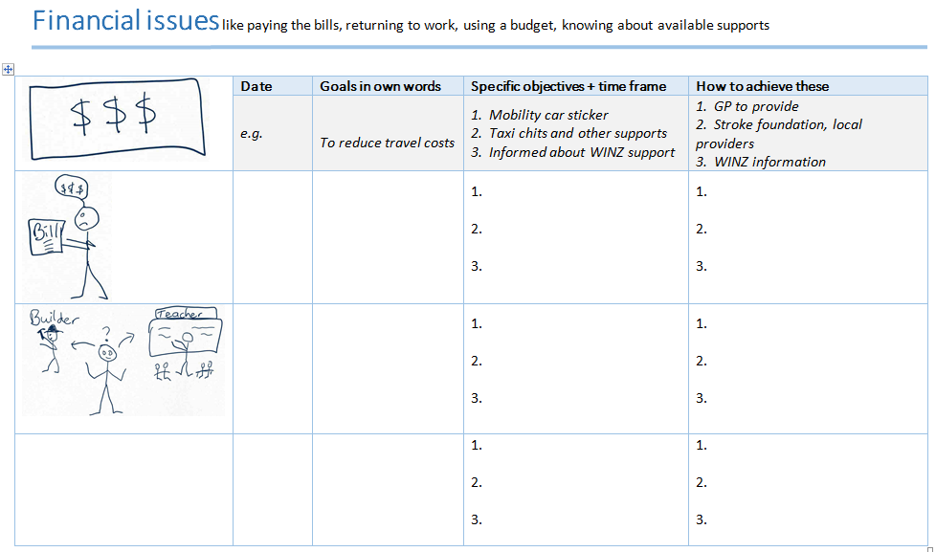
Notes:
There are several other sheets covering common issues for people after stroke with a structure that allows them to plan for the future

Slide 21
Quality of life
Maori and Pacific Stroke Study n = 172 RCT, 80% follow-up
Taking Charge after Stroke Study n = 400 RCT, >99% follow-up
SF36 measures health-related quality of life. MCID of the PCS in stroke = 2-3
N = 572
Notes:
So briefly to a few numbers about effectiveness.
There have been 2 RCTs, both using the physical component summary of the short form 36 as the primary endpoint, a well-validated measure of health related quality of life. The minimal clinically important difference is somewhat controversial in stroke but possibly around 2-3 points..
The first study was of 172 maori and Pacific people in new zealand, published in 2011
and the second of 400 predominantly white new Zealanders published this month
A pooled difference of almost 4 points with fairly narrow confidence intervals

Slide 22
Independence
Modified Rankin Score (mRS) measures ‘functional outcome’; scores 0-2 = independent; 3-5 increasing levels of dependence
NNT for 1 more person to be independent at 12 months = 7.9
Notes:
The modified Rankin scale is probably more familiar to some. As an outcome measure it is often dichotomised with scores of <3 signifying independence and scores of 3 and more, increasing dependence. Any statistically significant difference in independence is considered clinically meaningful.
.
Overall, you only need to expose 8 people with stroke to the Take Charge intervention for 1 more person to be independent at 12 months

Slide 23
2 sessions better than 1
+ 2 points
+ 2 points
3 or 4 sessions?
1 session
2 sessions
Notes:
There was a statistically significant increase in the PCS with each dose of Take Charge. Doses greater than 2 are yet to be tested.

Slide 24
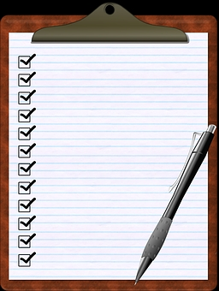
“But we are doing this already”
Probably not
Review:
Rosewilliam S, Roskell C, Pandyan A. (2011). A systematic review and synthesis of the quantitative and qualitative evidence behind patient-centered goal setting in stroke rehabilitation. Clin Rehabil, 2011;25,:501–14
The clipboard test
Notes:
I have often been told by clinical teams that they do person centred goal setting already. Evidence suggests that this is often not the case.
I have 2 simple tests. Firstly if the process is referred to as ‘patient-centred’ rather than ‘person-centred’ that suggests to me a stroke-centric rather than whole person approach.
Secondly I ask the therapists ‘who is holding on to the clipboard and pen?’ during goal setting. If it is not the person with stroke, I doubt this is person-centred.

Slide 25
Traditional goal-setting vs Take Charge
Traditional Goal setting | Take Charge
Generic goals tailored to the individual | Completely personal
Structured | Loosely structured
Teacher/coach/counsellor | Reflecting the person’s own thoughts
Clinician talking | Facilitator listening, not talking
Focus on what is do-able | Focus on what the person wants
Complete plan of future action | No written plan at the end of a session is OK
‘SMART’ (Specific/Measurable/Achievable/Realistic/Timed) | Anti-SMART
Time limited (often 45 min) | No time limit (often 45 – 90 minutes)
Notes:
These are the main differences we see between traditional goal setting and Take Charge. This is not intended as criticism – just explaining what is different.
I will highlight 2: in traditional goal setting the clinician generally takes the role of teacher or coach and does most of the talking. For Take Charge we train the facilitators only to reflect the person’s own thoughts and ideas and not to offer any suggestions themselves.
Secondly Take Charge is anti SMART.

Slide 26
Take Charge is anti-SMART
S - specific
M - measurable
A - achievable
R - realistic (relevant)
T - time-related
Notes:
SMART goal setting may be good in factories and places where efficiency targets need to be met but we believe SMART goal setting lowers horizons and impedes intrinsic motivation. We want people to be dreaming big – going back to work, starting a new job, watching their grand-daughter’s team play football on Saturday mornings, going on a trip through rural Vietnam – it is not necessary that it be terribly realistic but it is does need to be the authentic dream of the person with stroke

Slide 27
£100
STROKE or other health condition
Barthel ↑3%
FAI ↑10%
Independence ↑ 8%
SF36 ↑10%
Body structure & function
Quality of life and independence
Activity limitation
Participation restriction
Personal factors
Personal factors
Take Charge
Improving intrinsic motivation
Environment
Notes:
So to summarise what Take Charge could achieve for your people with stroke

Slide 28
Number needed to treat (NNT) for death or independence
Stroke unit care 20 (mainly deaths prevented)
Aspirin acutely 100
IV tPA within 3 hours 10
Mechanical thrombectomy 5
Take Charge 8 (independence)
Notes:
To underline the importance of stroke rehabilitation interventions for people with stroke, we can compare the effect of Take Charge to current treatments using the number needed to treat:
Remember this result for Take Charge is in addition to other treatments.

Slide 29
Why stroke rehabilitation is so important
Your next 1000 people admitted to hospital with stroke: Benefit of treatments on death/dependence
Stroke unit care 50 (NNT = 20, 100% eligible)
Aspirin acutely 9
IV tPA within 3 hours 12
Mechanical thrombectomy 5 (current) – 15 (potential)
Hemicraniectomy for malignant MCA infarction 5 (mainly deaths avoided)
Take Charge 62 (NNT = 8, 50-60% eligible)
(in addition to best stroke rehab)
Notes:
So this is why stroke rehabilitation is so important. If you have an effective treatment and can apply it to a large proportion of people with stroke, the total number of people helped can be considerable

Slide 30
Sufficient evidence to change clinical practice?
Level 1a evidence of benefit for independence in stroke
Benefit at 6 months, sustained at 12 months
Dose effect
Effective in both ethnic-minority and ethnic-majority populations
No harm
Cheap
Training easy
[Cost saving, not yet published]
Notes:
So what do you need to change clinical practice?
In stroke alone, the level of evidence for much of what we do falls below this

Slide 31
Practical issues
Which patients and how many sessions
Integrate with current rehabilitation services or ‘add-on’?
The facilitator
Good listener
Maybe not a rehabilitation clinician
Older person?
Training: this webinar + read the training manual is sufficient – email any questions. Skype or Zoom session for bigger groups? Get in touch.
Training/ booklet modification if necessary
Materials all free on the website: www.mrinz.ac.nz/programmes/stroke
Send us any translations so that we can post these for others (German, Estonian, Russian underway)
Notes:
Well, to use Take Charge you really only need to make 4 decisions:
Which patients and how many sessions
Will you modify your current practice or add this on
Who will be the facilitator and training them
Modification of the Take Charge booklet if necessary

Slide 32
People who achieve amazing things dream of amazing things
Intrinsic motivation is a necessary condition for successful rehabilitation
What the person with stroke can do for themselves, is as much as anything clinicians can do to them
Take Charge puts the person with stroke in the driving seat – where they belong
Take Charge aims for transformation: from a stroke person to a person who happens to have had a stroke
Notes:
And so we come back to Runa from Assam, who rehabilitated herself from a severe stroke – a few days in hospital, never saw a physio or an OT. Driven by the need to get back to work as a farmer to support her daughter through school.

Slide 33
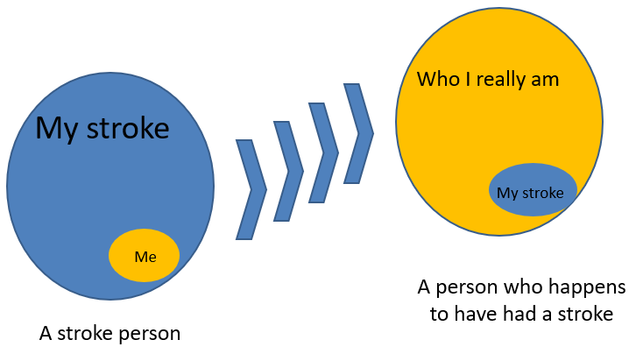
Experience Take Charge for yourself
Materials free to download and modify
www.mrinz.ac.nz/programmes/stroke
3 different ways to think about using Take Charge to enhance stroke outcomes
Julia
Notes:
So please download the materials and start using Take Charge for yourselves. The intervention isn’t limited to healthcare professionals, or even to stroke. People with stroke can access and use the materials themselves if they wish.
I have given you 3 different ways to think and talk about Take Charge which I hope will be helpful

Slide 34
Research potential!
Take Charge
More sessions?
Timing of first intervention?
Conditions other than stroke?
International study?
Using Take Charge to enhance new therapy interventions
Alternatives to Take Charge?
Better measures of ‘intrinsic motivation’, outcome
Notes:
And of course, Take Charge opens up an enormous potential field for research

Slide 35
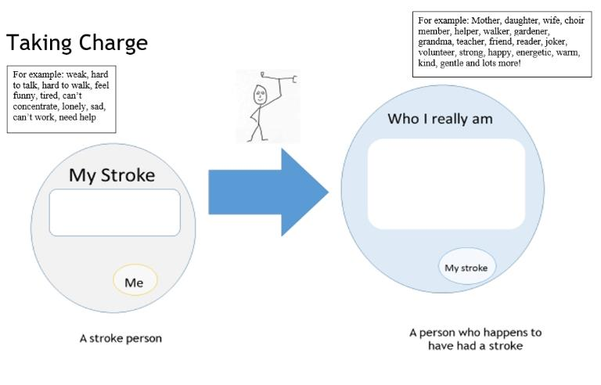
Contacts and links
Harry McNaughton
Stroke department, Royal Derby Hospital
Harry.mcnaughton@nhs.net
Harry.mcnaughton@mrinz.ac.nz
Take Charge booklet and training manual
www.mrinz.ac.nz/programmes/stroke
Main paper results: https://doi.org/10.1177/1747493020915144
Notes:
End of main presentation. The following slides respond to specific questions from the webinar

Slide 36
“But what did they do after Take Charge?”
We don’t know for sure. So much unknown about the psychology of recovery from illness – likely to be very individual
Not more face-to-face rehab
(In my opinion) It’s not about ‘more therapy’ (compare what we know about elite athletes, musicians, students studying – more about motivation, focus, engagement)
Some insights from qualitative study (unpublished)
Permission to do my own thing
Rebel against paternalistic doctors and therapists ‘one size fits all’, ‘scripted’
Therapists ‘obsessed with safety’ – I’m not allowed to take risks (compare Julia)
Felt properly listened to for the first time
Came to a better understanding of ‘who I really am’
Better focussed on what is really important (to me)
Working out a plan over time – booklet helped with ‘big ideas’ and simple structure to ‘get on’
Alan's story
Notes:
Alan’s story: Retired in his 60s. Wife died some years ago with cancer. Glass half full kind of guy. Devoted daughters who live in same town. Major stroke with significant mobility issues after several weeks in hospital. Housebound since stroke. First Take Charge session going badly. During baseline assessment Alan kept saying ‘I’m stuffed’ (ie useless), and ‘the physio knows it is hopeless’. He got to the 3rd page of the booklet ‘My Best day’ and just said ‘What can I do – I’m stuffed’. The facilitator asked, ‘What did you enjoy doing before?’ and he still wasn’t able to answer. One of his daughters reminded him that the thing he liked doing the most since his wife died was to go once a week to the local shopping mall and sit outside a café drinking coffee and watching the world go by. Alan said ‘Well I can’t do that now, can I?’. His daughters took on the challenge and organised a wheelchair taxi to take him to the mall the next week. Alan felt very self-conscious and uncomfortable about the whole thing but went along with it. He was touched by the number of people who came up to him and said ‘we’ve missed you’ and how good it was to see him there after the stroke that they all seemed to know about. He went every week after that. By the time of the 2nd Take Charge session 6 weeks later, there was no difference in his overall mobility but he was a different man. One daughter said ‘He has got his zest for life back’. He filled in a lot more of the booklet and started making concrete plans for the future – ‘I’m not going to live like this for the rest of my life’. Alan was clearly ‘looking beyond his stroke’. Would that have happened without Take Charge? Who knows.

Slide 37
Permission to take risks and fail
Michael Jordan, the greatest basketballer to play the game
"I've missed more than 9,000 shots in my career. I've lost almost 300 games. Twenty-six times, I've been trusted to take the game winning shot and missed. I've failed over and over and over again in my life”

Slide 38
From the facilitators’ perspective
Judith’s story ‘I was going to say that …
Privilege to share the stories of people with stroke in their own homes
Therapists turned facilitators
‘so hard not to say anything’
‘so wanted to ‘help’ but you told me not to!’
‘amazing to see the look on their face when they started to talk about what they really wanted’
‘They said ‘no-one has ever asked me questions like this before’. How can that be possible?’
‘The first session was a wash out but the second was amazing’

Slide 39
What’s in a phrase?
Self-management (SM) vs self-directed rehab (SDR)
Depends on resources available
‘DIY’ (SM) vs employing the top mechanical engineers for your car (SDR)
But some things always better done yourself (eg risk factor management?)
Who is driving the car?
Take Charge vs intrinsic motivation
Take Charge is the name of the intervention
People with stroke can relate to it
The person with stroke is undoubtedly the subject not the object
You can’t ‘do’ Take Charge ‘to’ someone, only ‘with’ someone
Intrinsic motivation describes the underlying principle
Possibly more confusing to use with people with stroke
Possible confusion with motivational interviewing

Slide 40
Take Charge for every day
Inpatients – I say to all patients and families: ‘the 3 most important things for a better outcome are’
A Dream for the future - ‘know where you want to be going’ (= Purpose) + Belief (= Mastery)
An Attitude (= Autonomy)
Permission to misbehave (like ‘Julia’)
A Person in your corner (= Connectedness) – Paul Farmer’s ‘accompagnateur’
Outpatients/GP: I ask:
‘What do you dream about for the future?’
‘What is your biggest fear?’
Notes:
But you could start using Take Charge now. This is what I try and do with every person I see.

Slide 41
Take Charge: timing
Stroke dogma: 95% of motor recovery complete by 12 weeks – ‘plateau’ effect
So how can an intervention at 3-16 weeks improve outcomes at 12 months?
Take Charge intervention
Motor recovery
‘Normality’ narrative
‘Live life whatever’ narrative
6 weeks
Notes:
Timing may be important. For many people with stroke, the normality narrative (I am going to get back to normal) remains strong in hospital and into the early community phase.
For many but not all people disabled by stroke, eventually a different narrative (making the best of what I’ve got) replaces this.
The timing of the Take Charge intervention might be important in helping people to leave their stroke behind.

