Slide 1









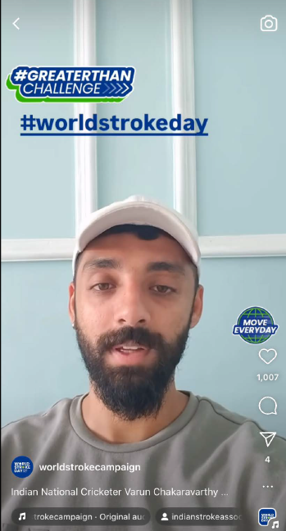
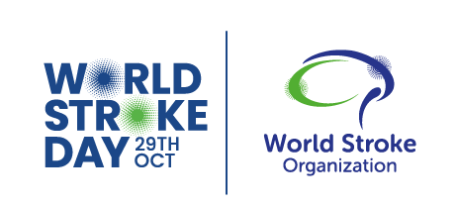



Influencer’s guide
What is World Stroke Day?
Why is it important?
World Stroke Day is held on 29th October each year. It is an opportunity to raise awareness of the serious nature and high rates of stroke, talk about prevention and treatment and ensure better care and support for survivors.
Every year, 12 million people experience a stroke. That’s one every two seconds. The sad truth is that 1 in every 2 people who experience a stroke will die from it. Knowing how to spot the signs of stroke and raising the alert is an essential first step that can help make sure people get the treatment they need, fast.
Impact in 2024
Total reach:
4.2 billion
Countries:
78
Community events: 170
instagram
&
tiktoK
How you can show your support World stroke day
1.
TikTok/Instagram Story published around 25th October reminding people that World Stroke Day is being celebrated on 29th October and that the theme is #ActFAST.
TikTok/Instagram post on 29th October
highlighting the campaign’s key messaging.
2.
@mentions
@WorldStrokeCampaign
#hashtags
#WorldStrokeDay #ActFAST
Follow us on:
@WorldStrokeCampaign
World Stroke Organization

